Slide 1
Hybrid Model
DSGT Workshops 01/27/2020

Slide 2
Hybrid?
Ensemble?

Slide 3
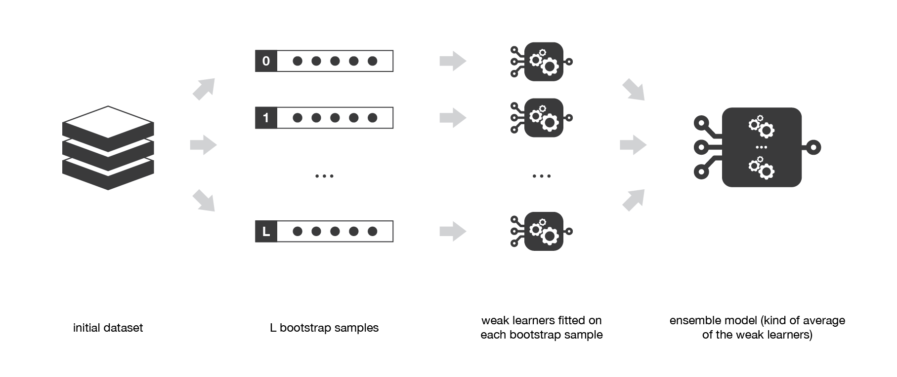
What do we know about “Ensemble”?
Notes:
Ensemble methods we have learned last fall: bagging, boosting (adaboost & gradient boosting), and stacking/multi-layer stacking.

Slide 4
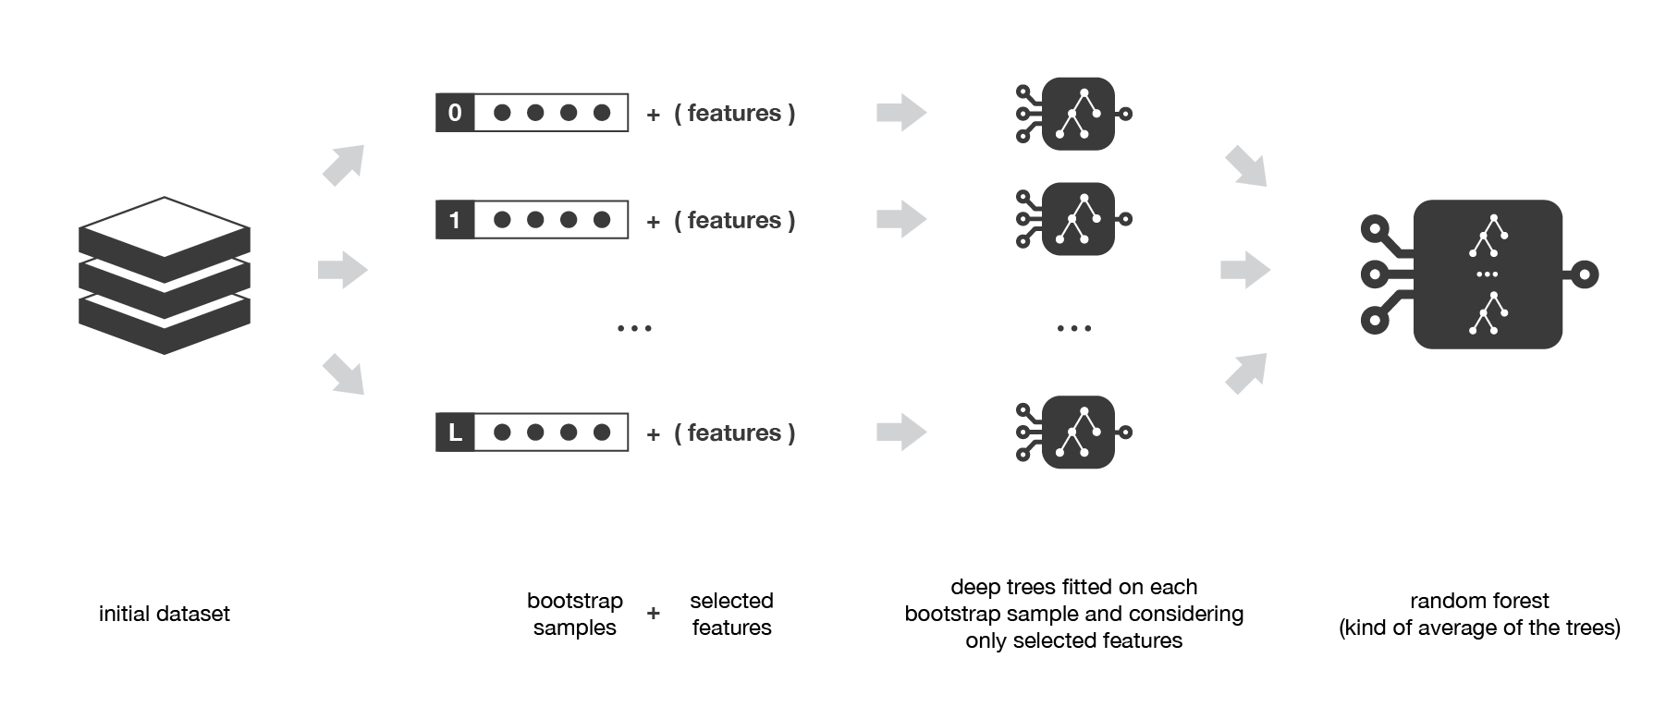
In particular, this is ____________ model
Notes:
(answer is in the slide)

Slide 5
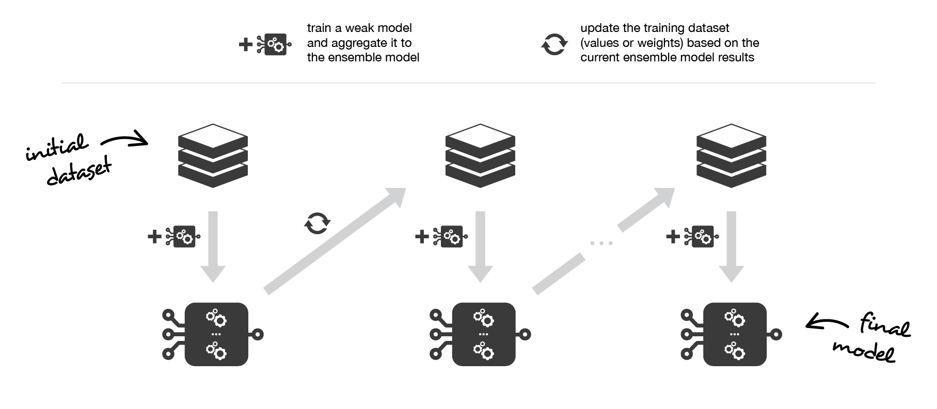
What about this?
Notes:
Is this bagging or boosting?

Slide 6
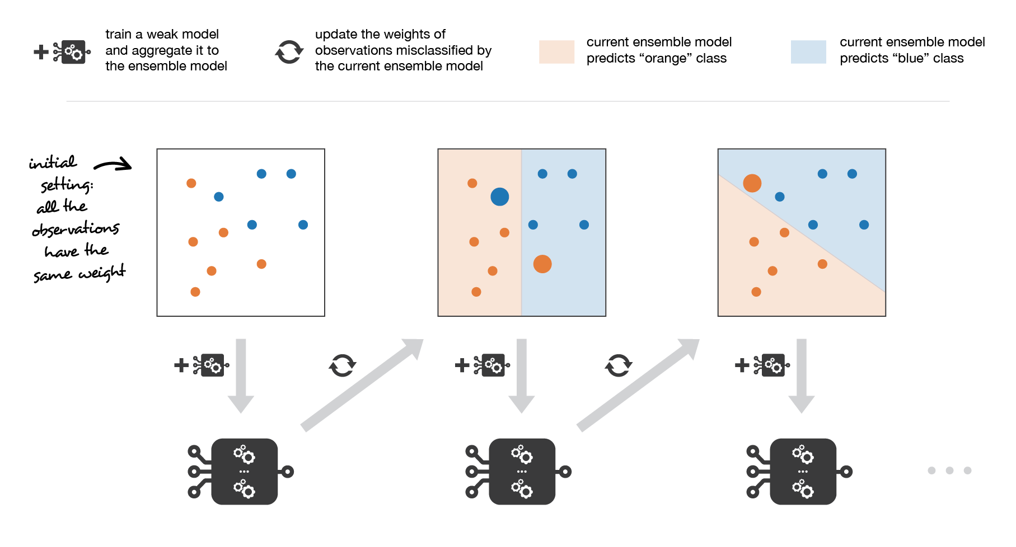
What kind of boosting is this?
Notes:
Each learner in the adaboost takes the output of the previous learner, increases the weights of those mis-classified, and inputs into a learner again.

Slide 7
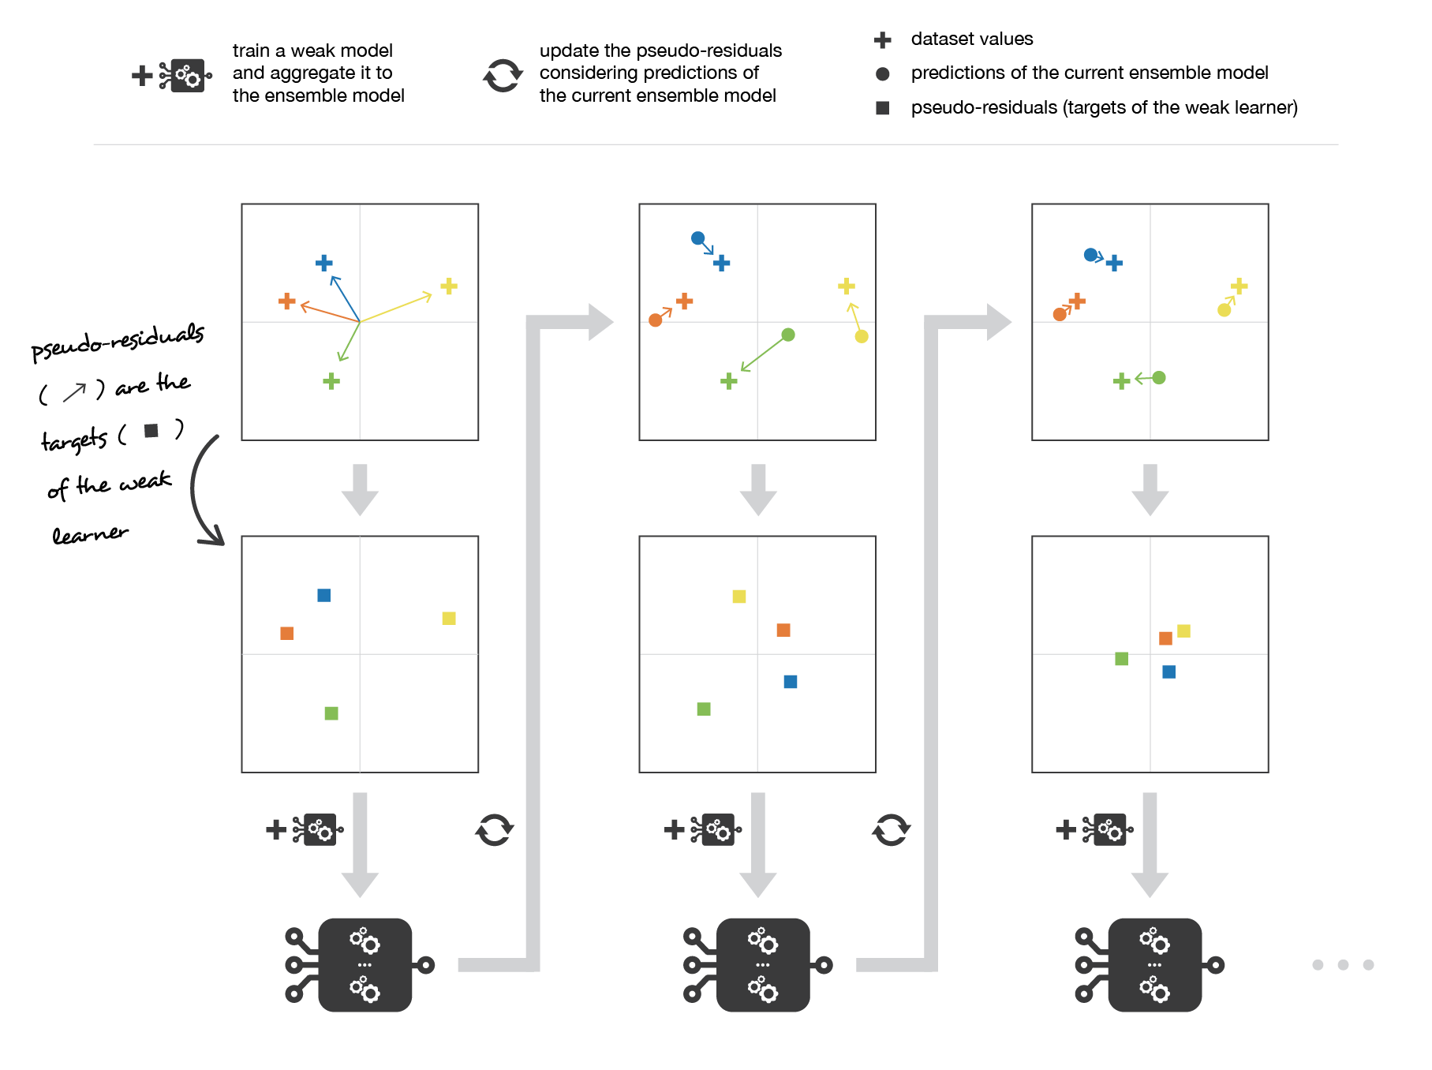
How does this one work?

Slide 8
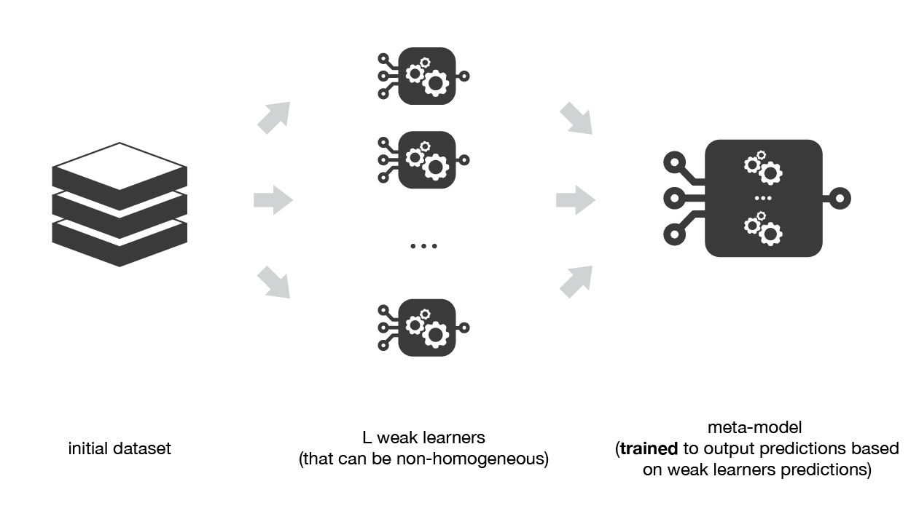

Slide 9
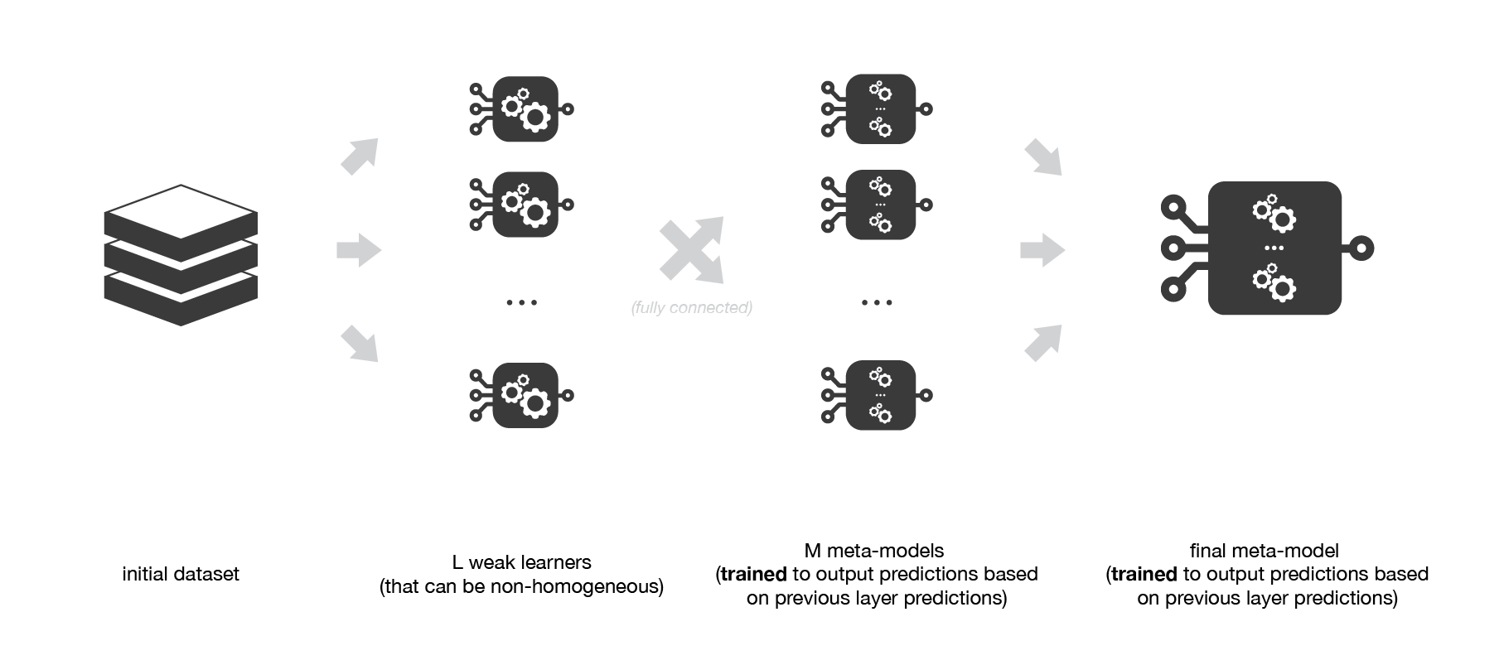

Slide 10
Case Study: Recommendation System

Slide 11
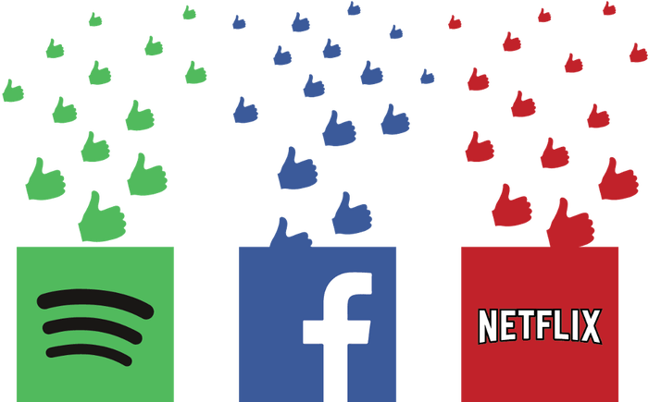
How can we predict a user’s selection and provide recommendation?
What can we use?

Slide 12
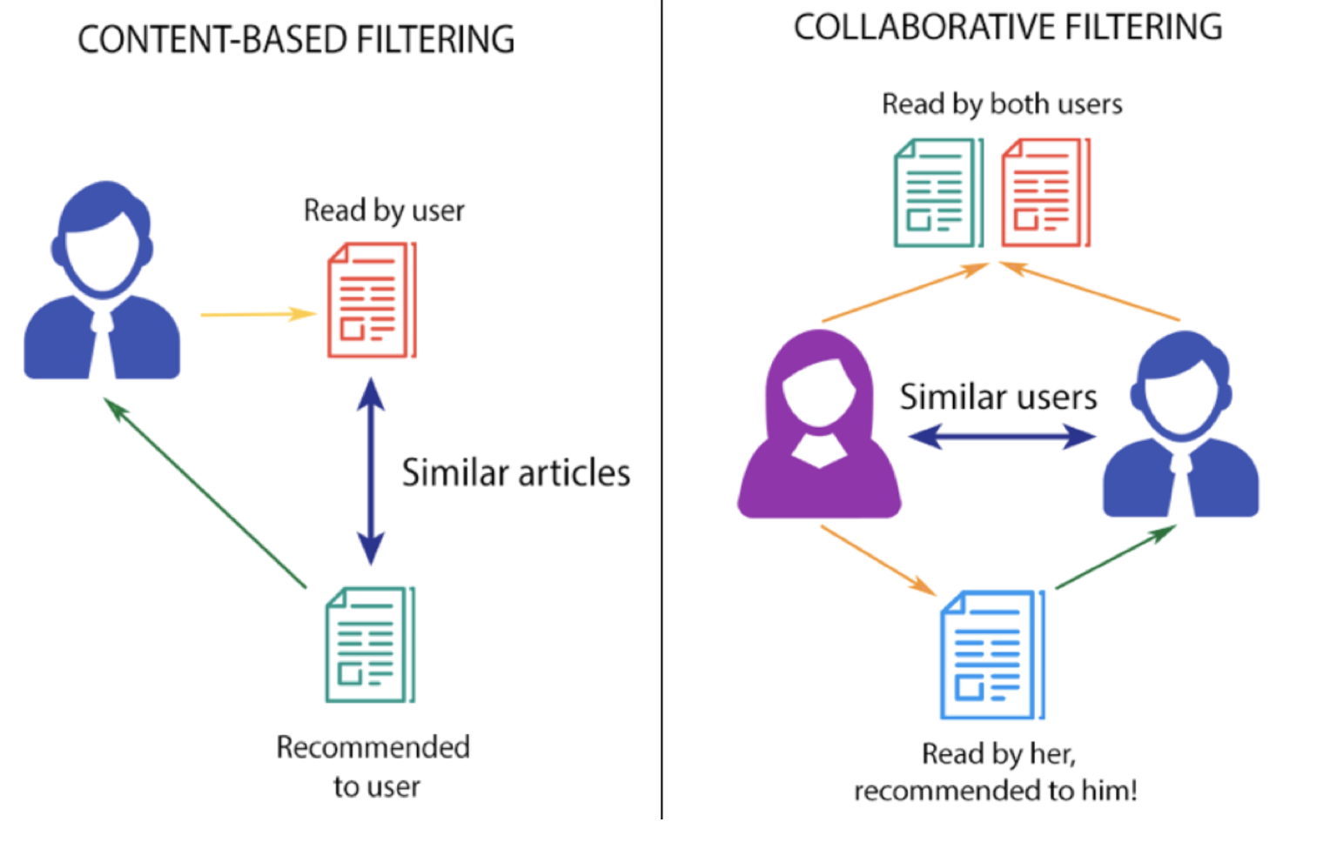

Slide 13
Collaborative Filtering
Assume similar people have similar tastes
Use weighted average to find how likely a user would choose a specific item based on the interaction of other similar people with that same item

Slide 14
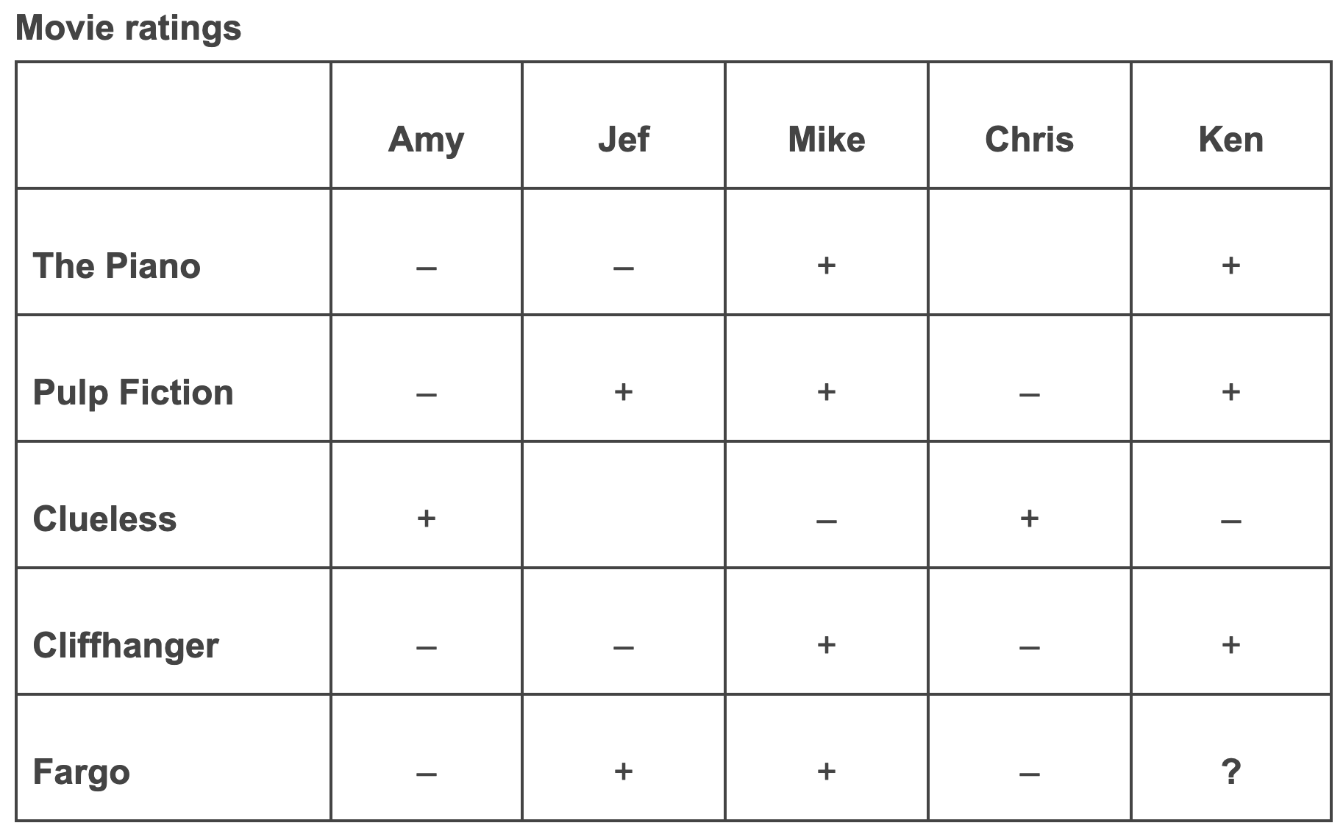
Neighborhood-based Approach

Slide 15
Cold Start
Product cold start
No reviews or history of being a success among a certain group of users
Visitor cold start
Not enough user actions to provide customized insights

Slide 16
Content-based Filtering
Parse item content and user profile to a standard
Vector Space model
Latent Semantic Indexing
Find items similar to those users have interacted with
Recommend to users

Slide 17
Use both approaches
to make our system
more accurate.

